Slide 1
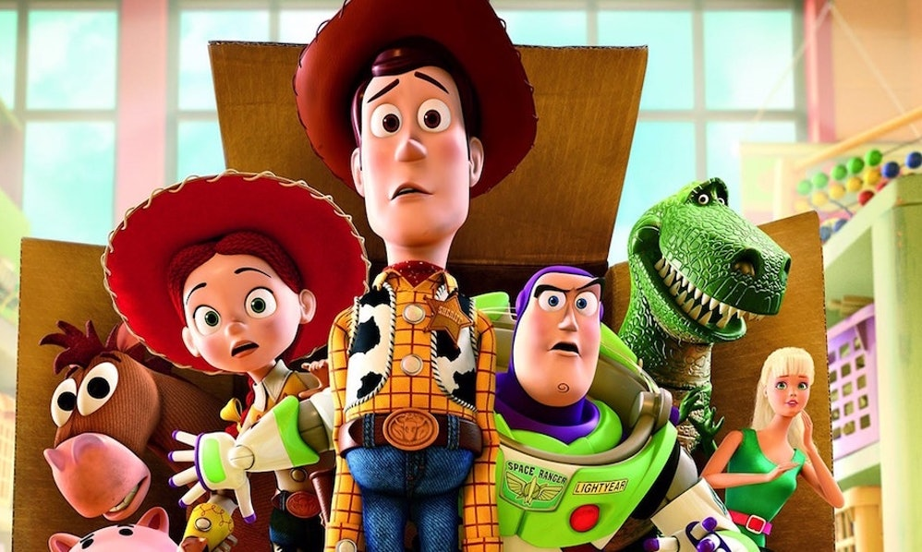

Graphics

Slide 2
Errors
What kind of bugs did you find in your code?
🤔

Slide 3

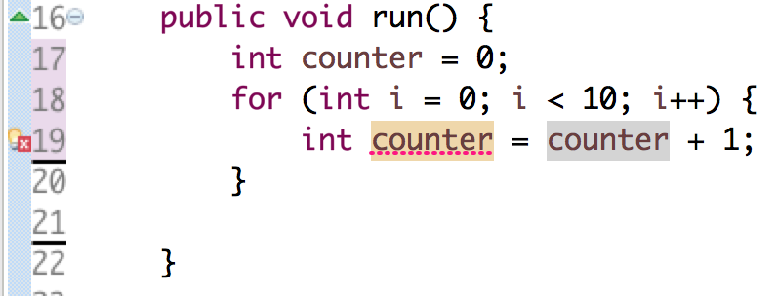

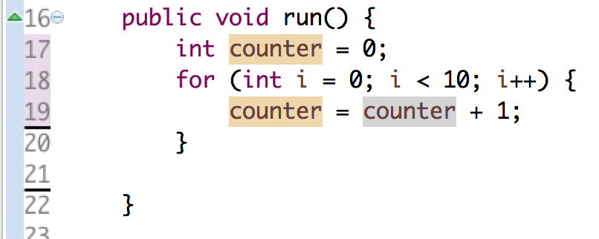
Reusing Variables
Duplicate variable counter
You only need to tell Java the type of a variable once.

Slide 4

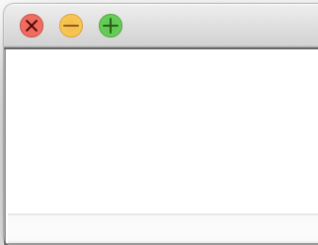
Updating Variable Values
“equals”
Evaluate right hand side
Store result in variable on left hand side
=
int year = 2019;
int prevYear = year;
year = year + 1; println(prevYear + " " + year);
println(prevYear + year);
???
year
prevYear
2019
2019
🤔

Slide 5
Updating Variable Values
“equals”
Evaluate right hand side
Store result in variable on left hand side
=
int year = 2019;
int prevYear = year;
year = year + 1; println(prevYear + " " + year);
println(prevYear + year);
2019 2020
4039
year
prevYear
2020
2019
🤔

Slide 6
Updating Variable Values
“equals”
Evaluate right hand side
Store result in variable on left hand side
=
double seconds = 60;
seconds--;
println(seconds);
59.0
seconds = seconds – 1;
???
int total = 15;
total /= 10;
println();
println(total);
1
total = total / 10;
???
The local variable age may not have been initialized
int age;
age = age + 1;
???
___
🤔

Slide 7


We Called Karel, Maybe
I’m back! Maybe
(2012)

Slide 8
Looping Beepers
How many beepers did Karel put down?
for (int i = 0; i < 5; i++) {
for (int j = 0; j < 4; j++) {
for (int k = 0; k < 3; k++) {
putBeeper();
}
} }
60
for (int i = 0; i < 3; i++) {
int countdown = 10;
while (countdown > 0) {
countdown -= 2;
putBeeper();
}
}

Slide 9
Looping Beepers
How many beepers did Karel put down?
for (int i = 0; i < 5; i++) {
for (int j = 0; j < 4; j++) {
for (int k = 0; k < 3; k++) {
putBeeper();
}
} }
3 x
60
for (int i = 0; i < 3; i++) {
int countdown = 10;
while (countdown > 0) {
countdown -= 2;
putBeeper();
}
}

Slide 10
Looping Beepers
How many beepers did Karel put down?
for (int i = 0; i < 5; i++) {
for (int j = 0; j < 4; j++) {
} }
4 x
3 x
60
for (int i = 0; i < 3; i++) {
int countdown = 10;
while (countdown > 0) {
countdown -= 2;
putBeeper();
}
}

Slide 11
Looping Beepers
How many beepers did Karel put down?
for (int i = 0; i < 5; i++) {
}
5 x
4 x
3 x
60
for (int i = 0; i < 3; i++) {
int countdown = 10;
while (countdown > 0) {
countdown -= 2;
putBeeper();
}
}

Slide 12
Looping Beepers
How many beepers did Karel put down?
for (int i = 0; i < 5; i++) {
for (int j = 0; j < 4; j++) {
for (int k = 0; k < 3; k++) {
putBeeper();
}
} }
60
for (int i = 0; i < 3; i++) {
int countdown = 10;
while (countdown > 0) {
countdown -= 2;
putBeeper();
}
}
Countdown: 10,8,6,4,2,0
15

Slide 13
Looping Beepers
How many beepers did Karel put down?
for (int i = 0; i < 5; i++) {
for (int j = 0; j < 4; j++) {
for (int k = 0; k < 3; k++) {
putBeeper();
}
} }
60
for (int i = 0; i < 3; i++) {
int countdown = 10;
while (countdown > 0) {
countdown -= 2;
putBeeper();
}
}
3 x
Countdown: 10,8,6,4,2,0
15

Slide 14
Programming takes practice.
Notes:
questions

Slide 15
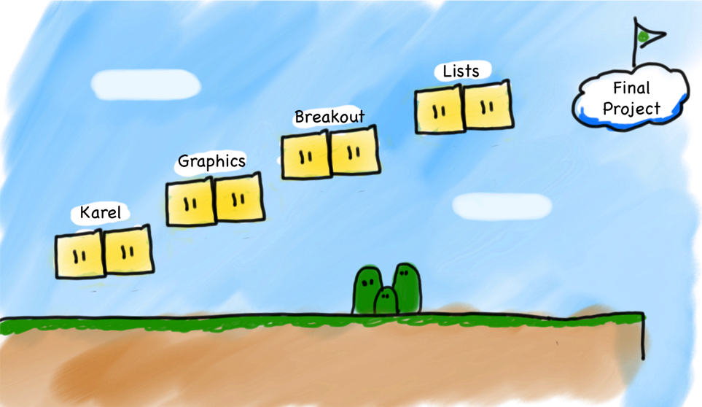
Our Second Step
Console
Programs
(but really, variables)
Notes:
Let's just jump straight into it!

Slide 16
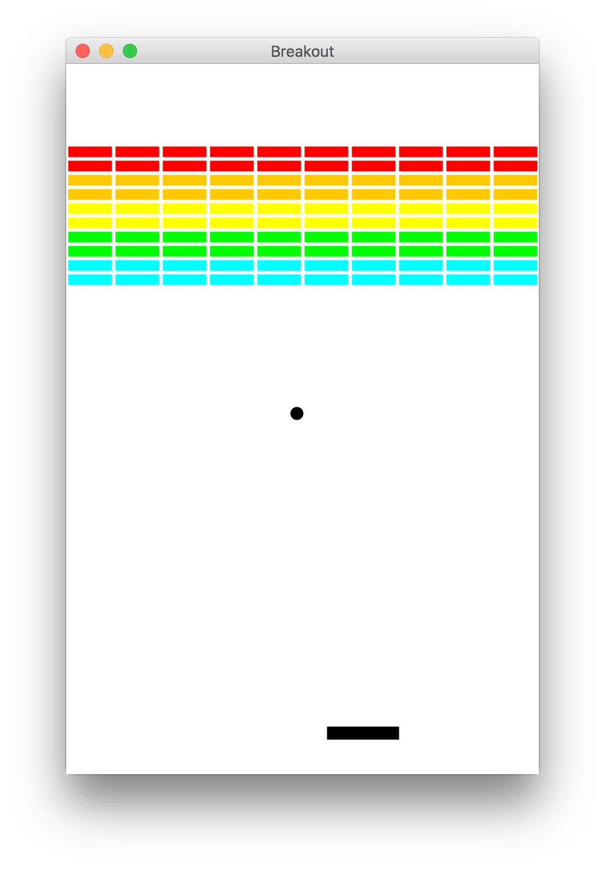
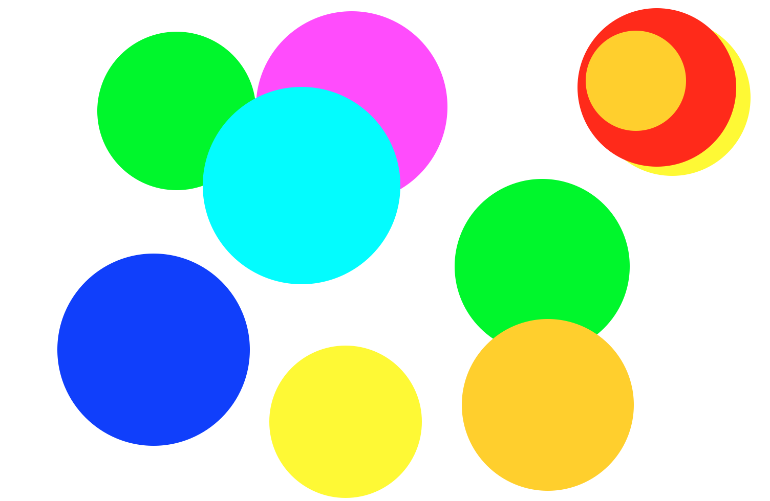
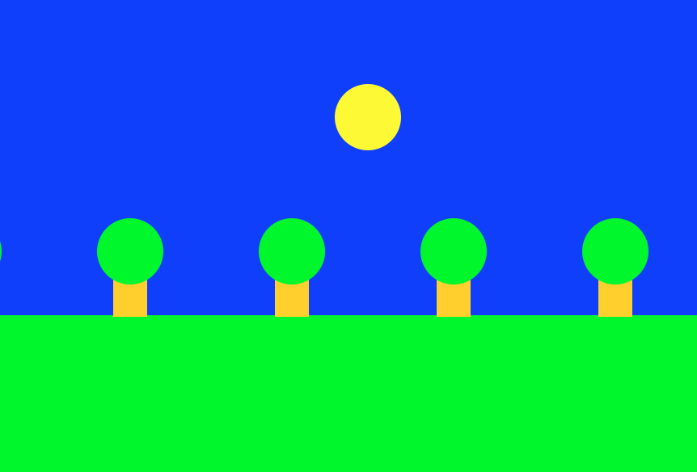
Beyond Console Programs

Slide 17
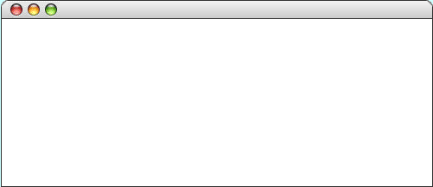
GRect
GRect is a variable that stores a rectangle.
As an example, the following run method displays a rectangle
public class WonderfulRect extends GraphicsProgram {
public void run() {
GRect rect = new GRect(220, 120);
rect.setFilled(true);
rect.setColor(Color.BLUE);
add(rect, 50, 50);
}
}
WonderfulRectangle
Notes:
pause and let them interpret it
(silently)

Slide 18
GRect
GRect is a variable that stores a rectangle.
As an example, the following run method displays a rectangle
public class WonderfulRect extends GraphicsProgram {
public void run() {
GRect rect = new GRect(220, 120);
rect.setFilled(true);
rect.setColor(Color.BLUE);
add(rect, 50, 50);
}
}
width:220
WonderfulRectangle
height:120
rect

Slide 19
GRect
GRect is a variable that stores a rectangle.
As an example, the following run method displays a rectangle
public class WonderfulRect extends GraphicsProgram {
public void run() {
GRect rect = new GRect(200, 200);
rect.setFilled(true);
rect.setColor(Color.BLUE);
add(rect, 100, 50);
}
}
⚠️ You must call add()to display things!
WonderfulRect
Coordinates for a rectangle are the top left corner.
y:50
x:100

Slide 20
Graphics Coordinates
0,0
40,20
120,40
getHeight();
40,120
getWidth();
The Graphics Canvas

Slide 21
Two GRects
GRect rect = new GRect(100, 100);
rect.setFilled(true);
rect.setColor(Color.BLUE);
add(rect, 50, 50);
rect.setColor(Color.GREEN);
add(rect, 150, 50);
TwoGRects
⚠️ multiple add() commands just move things around!
GRect rectB = new GRect(100, 100);
rectB.setFilled(true);
rectB.setColor(Color.BLUE);
add(rectB, 50, 50);
GRect rectG = new GRect(100, 100);
rectG.setFilled(true);
rectG.setColor(Color.GREEN);
add(rectG, 150, 50);
TwoGRects
This draws two separate rectangles.
Notes:
pause and let them interpret it
(silently)

Slide 22
Questions?

Slide 23
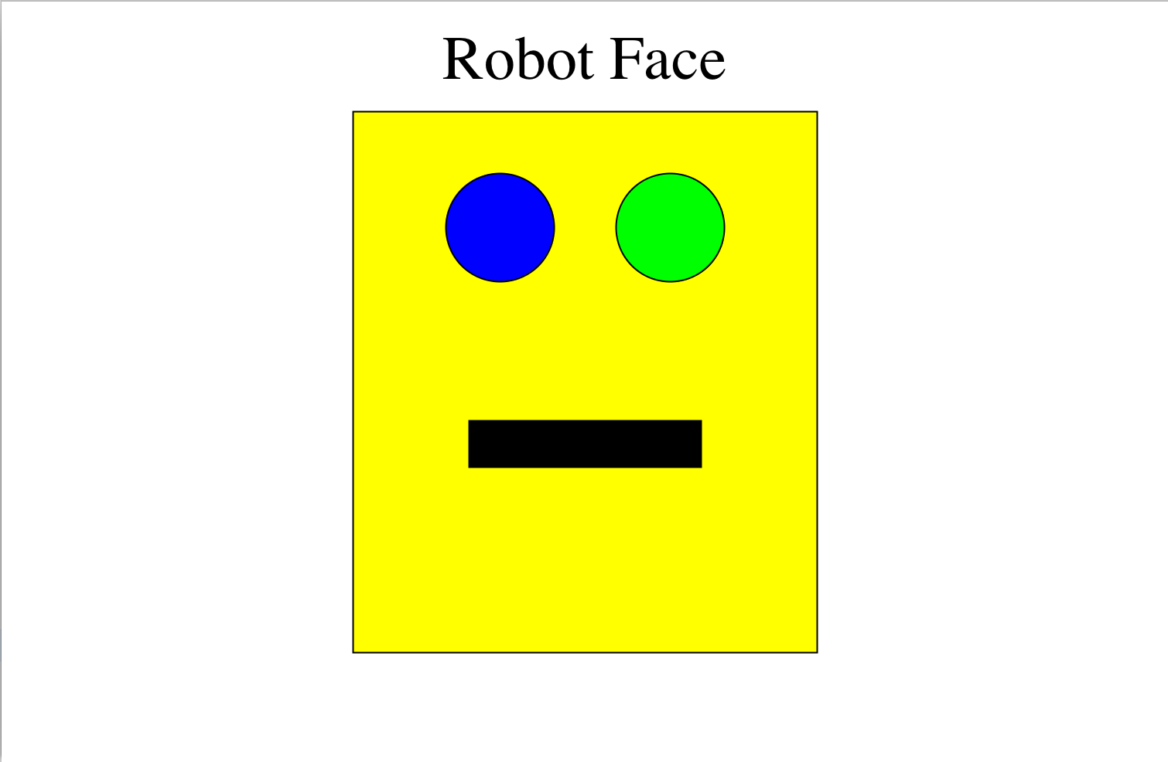
Karel’s Grandpa

Slide 24
Karel’s Grandpa
public void run() {
drawHead();
drawMouth();
drawLabel();
drawEyes();
}

Slide 25
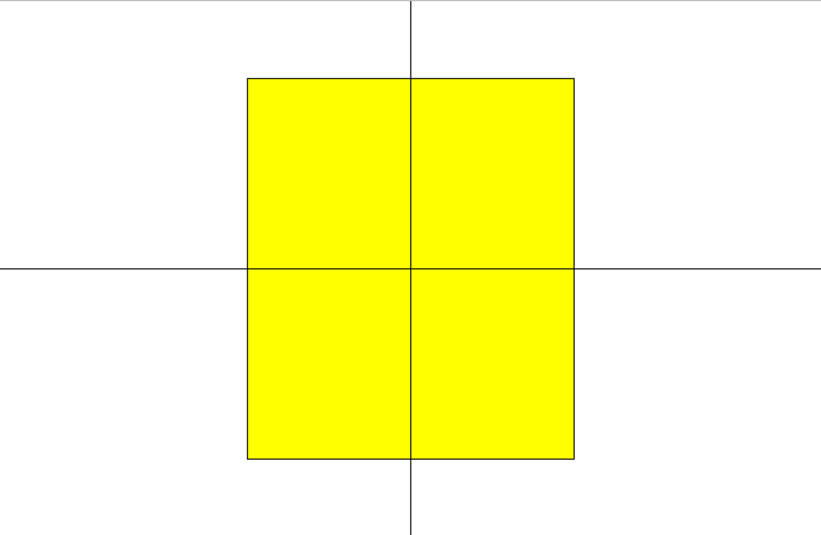
drawHead()
(x, y)?

Slide 26

drawHead()
rect.getWidth()/2
rect
getWidth()/2
double headX = getWidth()/2 - rect.getWidth()/2;
or
double headX = (getWidth() – rect.getWidth())/2;

Slide 27
drawHead()
getHeight() / 2
rect.getHeight() / 2
rect
double headY = getHeight()/2 - rect.getHeight()/2;
or
double headY = (getHeight() – rect.getHeight())/2;

Slide 28
Karel’s Grandpa
public void run() {
drawHead();
drawMouth();
drawLabel();
drawEyes();
}
✓

Slide 29
Constants
Once constants are defined, they cannot be changed anywhere.
Constants might have a lot of syntax, but they are easy to use.
public class RobotFace extends GraphicsProgram {
/* The distance from the top of the head * to the top of the mouth */
private static final int MOUTH_Y_OFFSET = 200;
public void run() {
drawHead();
drawMouth();
drawLabel();
drawEyes();
}
}

Slide 30
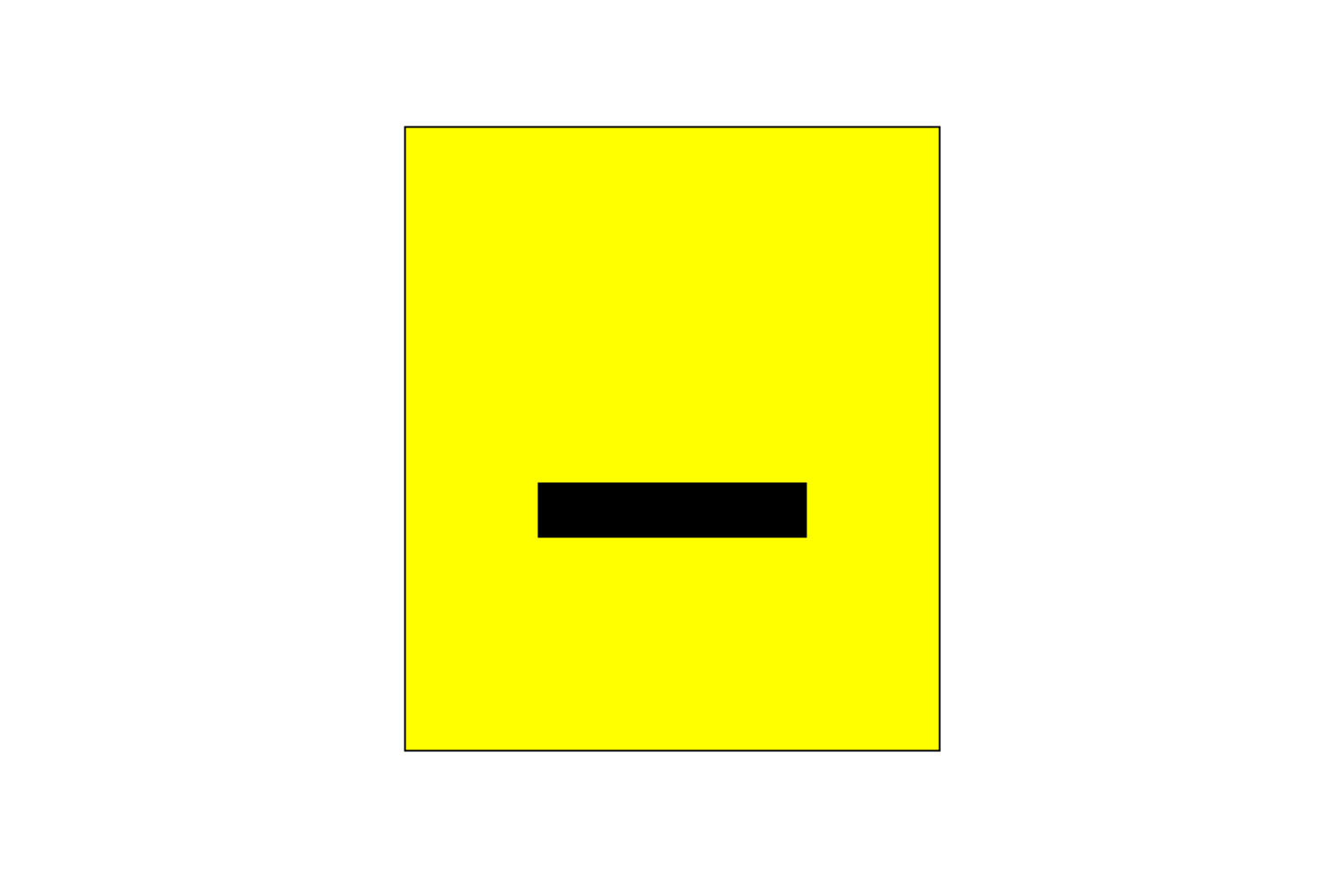
drawMouth()
/* The distance from the top of the head to the top of the mouth */
private static final int MOUTH_Y_OFFSET = 200;

Slide 31
drawMouth()
public class RobotFace extends GraphicsProgram {
private static final int MOUTH_Y_OFFSET = 200;
... // more constants, hidden
private void drawMouth() {
double headX = ...;
double headY = ...;
double mouthX = ...
double mouthY = ????????
GRect mouth = new GRect(
mouthX, mouthY,
MOUTH_WIDTH, MOUTH_HEIGHT);
?????????
?????????
}
... // more code
}
(headX, headY)
MOUTH_Y_OFFSET
(mouthX, mouthY)?
Calculate mouthY
Add the black filled in mouth to canvas

Slide 32
drawMouth()
public class RobotFace extends GraphicsProgram {
private static final int MOUTH_Y_OFFSET = 200;
... // more constants, hidden
private void drawMouth() {
double headX = ...;
double headY = ...;
double mouthX = ...
double mouthY = ????????
GRect mouth = new GRect(
mouthX, mouthY,
MOUTH_WIDTH, MOUTH_HEIGHT);
?????????
?????????
}
... // more code
}
headY + MOUTH_Y_OFFSET;
(headX, headY)
mouth.setFilled(true);
MOUTH_Y_OFFSET
(mouthX, mouthY)?
add(mouth);
Calculate mouthY
Add the black filled in mouth to canvas

Slide 33
Karel’s Grandpa
public void run() {
drawHead();
drawMouth();
drawLabel();
drawEyes();
}
✓
✓

Slide 34
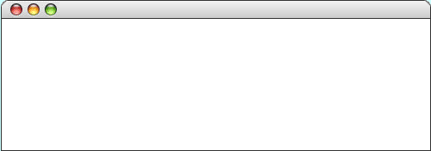
GLabel
A variable that represents text.
public class HelloProgram extends GraphicsProgram {
public void run() {
GLabel label = new GLabel(
”hello, world”, 100, 75);
label.setFont(“SansSerif-36”);
label.setColor(Color.RED);
add(label);
}
}
HelloProgram
HelloProgram
hello, world

Slide 35
GLabel
A variable that represents text.
public class HelloProgram extends GraphicsProgram {
public void run() {
GLabel label = new GLabel(
”hello, world”, 100, 75);
label.setFont(“SansSerif-36”);
label.setColor(Color.RED);
add(label);
}
}
HelloProgram
HelloProgram
75
100
hello, world

Slide 36
drawLabel()
/* The distance from the top of the screen to the base of the label */
private static final int LABEL_Y = 50;

Slide 37
drawLabel()
public class RobotFace extends GraphicsProgram {
/* The distance from the top of the screen * to the base of the label */
private static final int LABEL_Y = 50;
...
private void drawLabel() {
GLabel label = new GLabel("Robot Face");
label.setFont(”Times New Roman-50");
/* Put the label on the canvas
* in the right place
*/
}
... // more code
}
?
Learned during exercise
🤔

Slide 38
drawLabel()
Programming time!
Learned during exercise

Slide 39
Karel’s Grandpa
public void run() {
drawHead();
drawMouth();
drawLabel();
drawEyes();
}
✓
✓
✓

Slide 40
GOval
The GOval class represents an elliptical shape defined by the boundaries of its enclosing rectangle.
As an example, the following run method creates the largest oval that fits within the canvas:
public void run() {
GOval oval = new GOval(getWidth(), getHeight());
oval.setFilled(true);
oval.setColor(Color.GREEN);
add(oval, 0, 0);
}
LargestOval

Slide 41
drawEyes()
/* The diameter of each eye*/
private static final int EYE_DIAMETER = 70;
/* The distance from the top of the head to the top of the eyes*/
private static final int EYE_Y_OFFSET = 40;
/* The distance in between the two eyes */
private static final int EYE_X_SEPARATION = 40;

Slide 42

drawEyes()
(headX, headY)
(leftX, eyeY)?
(rightX, eyeY)?
/* The diameter of each eye*/
private static final int EYE_DIAMETER = 70;
/* The distance from the top of the head to the top of the eyes*/
private static final int EYE_Y_OFFSET = 40;
/* The distance in between the two eyes */
private static final int EYE_X_SEPARATION = 40;
In the drawEyes() method:
double eyeY = headY + EYE_Y_OFFSET;
double leftX = getWidth()/2 - EYE_X_SEPARATION/2 - EYE_DIAMETER;
double rightX = getWidth()/2 + EYE_X_SEPARATION/2;

Slide 43
drawEyes()
Programming time!
Notes:
Switch to code and let them discuss

Slide 44
Karel’s Grandpa
public void run() {
drawHead();
drawMouth();
drawLabel();
drawEyes();
}
✓
✓
✓
✓

Slide 45
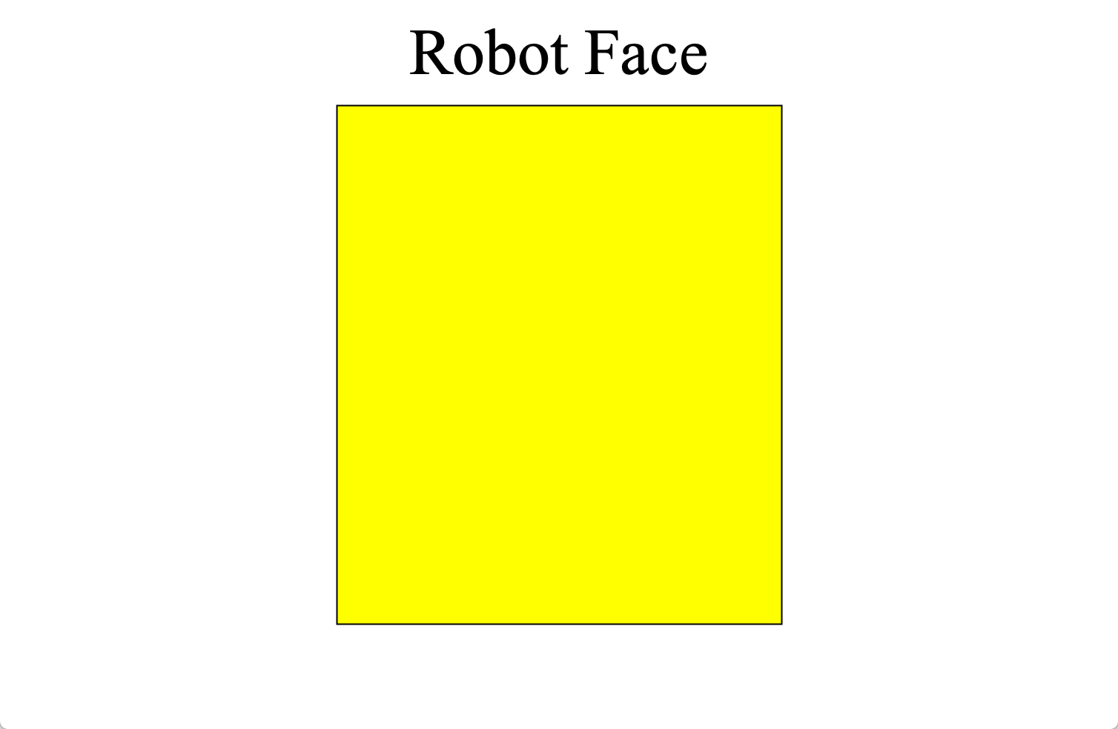
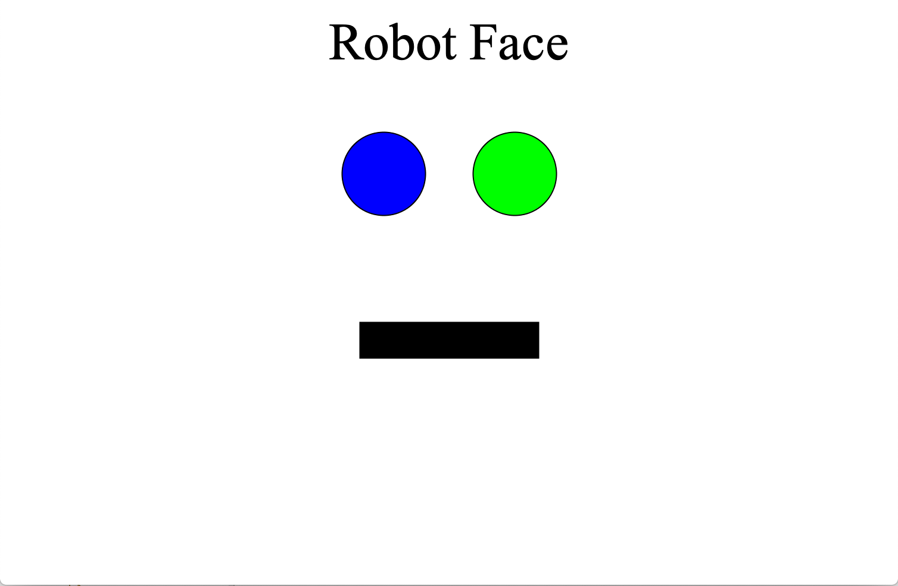
Not Karel’s Grandpa
public void run() {
drawMouth();
drawLabel();
drawEyes();
drawHead();
}
⚠️ Order of add()matters!

Slide 46
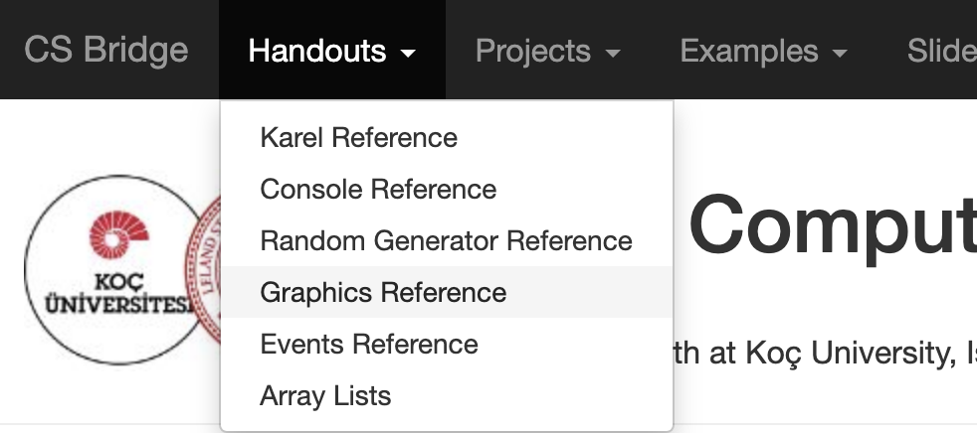
Graphics Methods Reference

Slide 47
Graphics Methods
add(object)
Adds the object to the canvas at the front of the stack
add(object, x, y)
Moves the object to (x, y) and then adds it to the canvas
remove(object)
Removes the object from the canvas
removeAll()
Removes all objects from the canvas
getElementAt(x, y)
Returns the frontmost object at (x, y), or null if none
getWidth()
Returns the width in pixels of the entire canvas
getHeight()
Returns the height in pixels of the entire canvas
setBackground(c)
Sets the background color of the canvas to c.
pause(milliseconds)
Pauses the program for the specified time in milliseconds
waitForClick()
Suspends the program until the user clicks the mouse

Slide 48
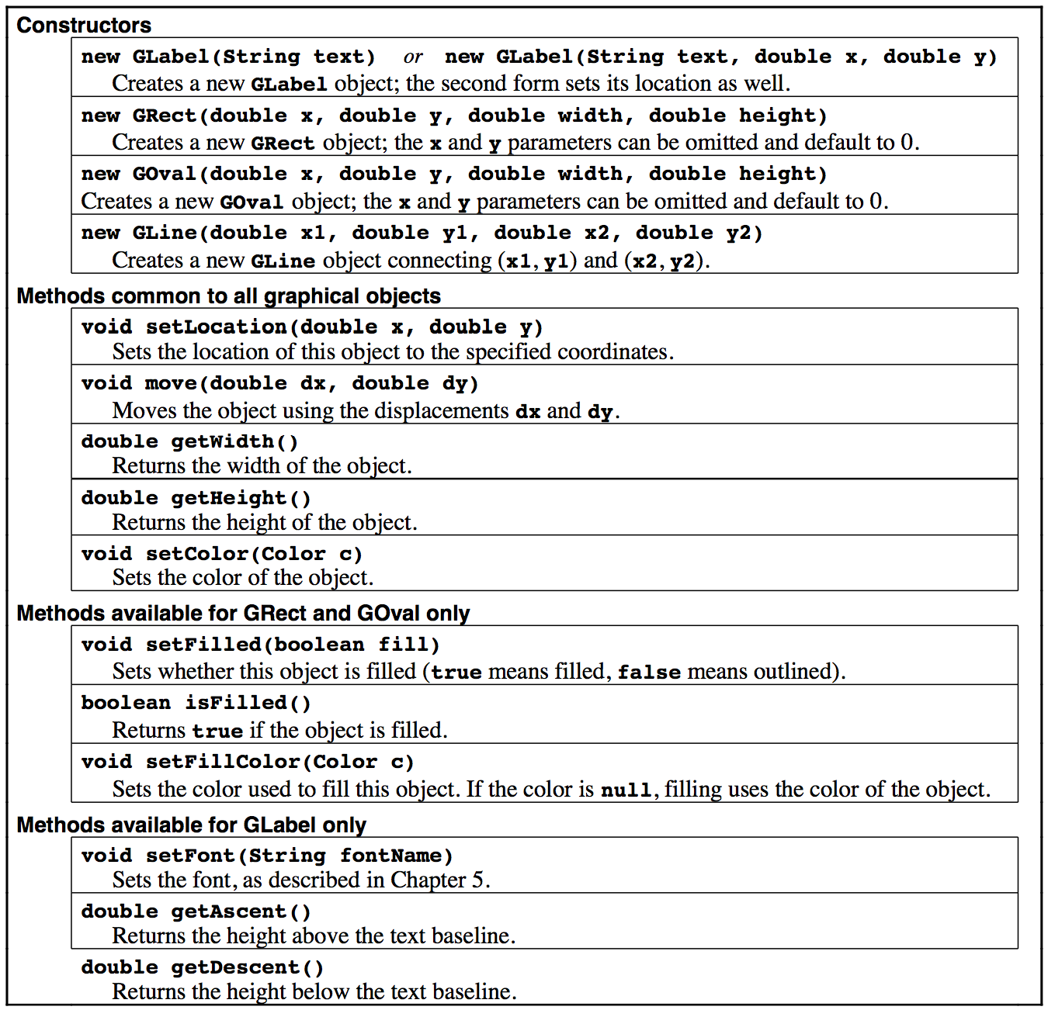
Reference Sheet

Slide 49
Time to Be Awesome
If you don’t finish, you can keep working in the afternoon!

Slide 50
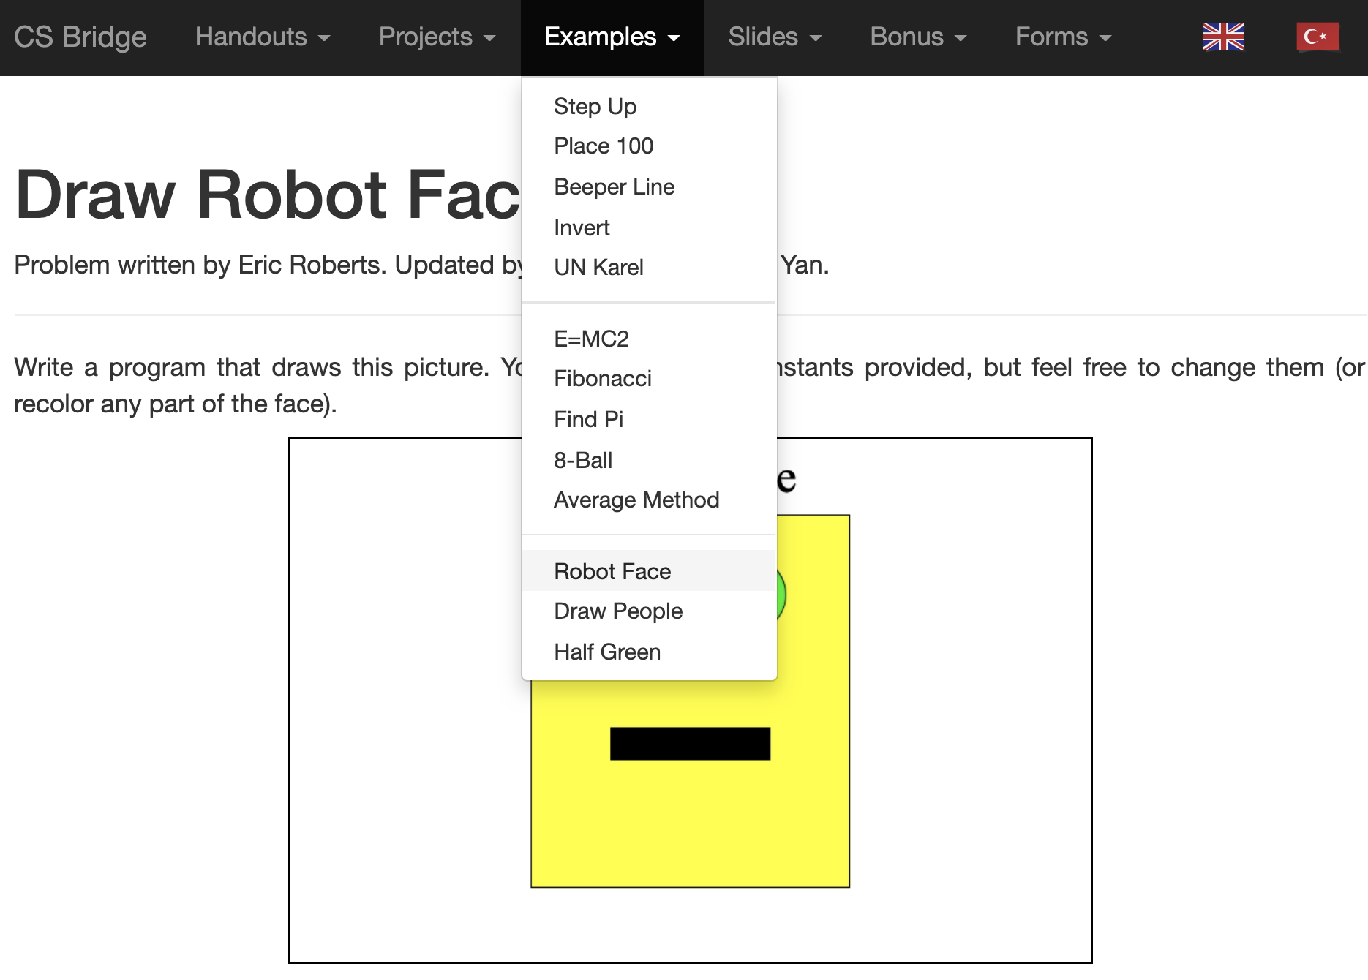
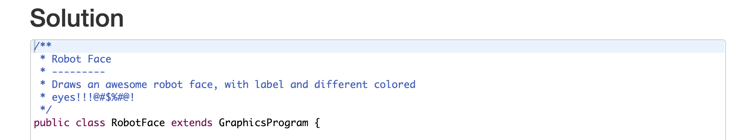
Karel’s Grandpa
Read the solution code if you get stuck!

Slide 51
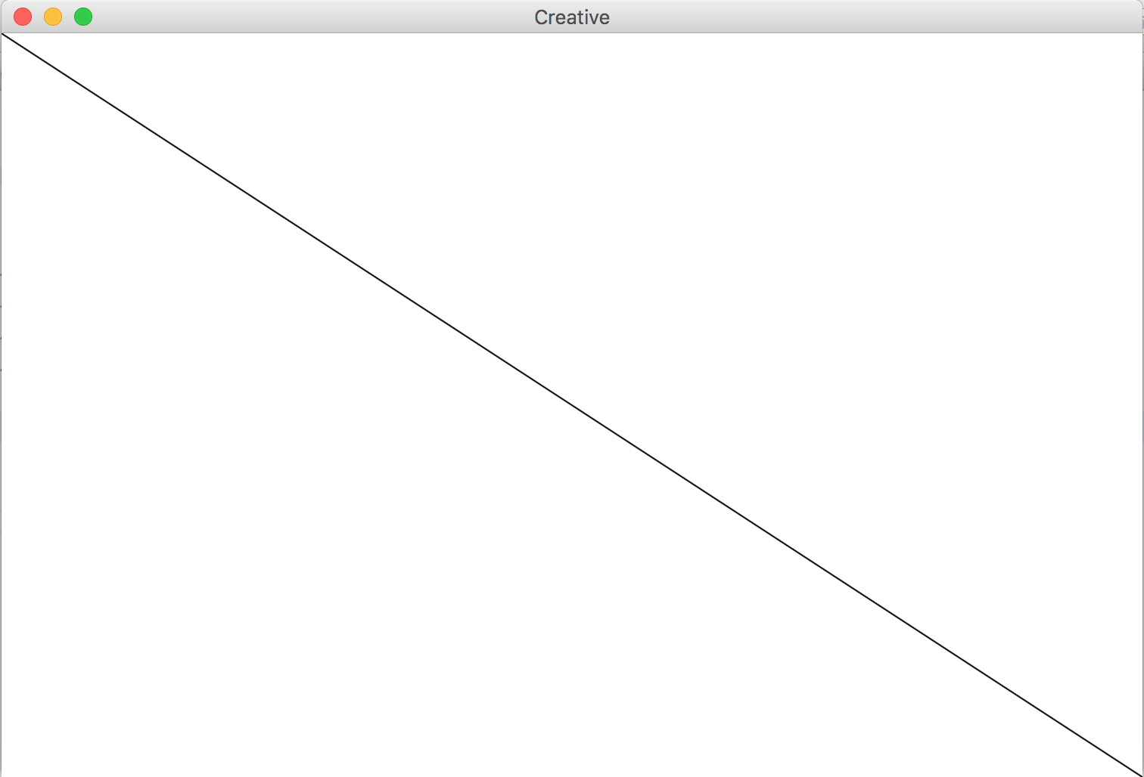
(bonus) GLine
The GLine class represents a line defined by a start point and an end point.
As an example, the following run method creates a diagonal line across the canvas:
public void run() {
GLine line = new GLine(0,0, getWidth(), getHeight());
add(line);
}

Slide 52
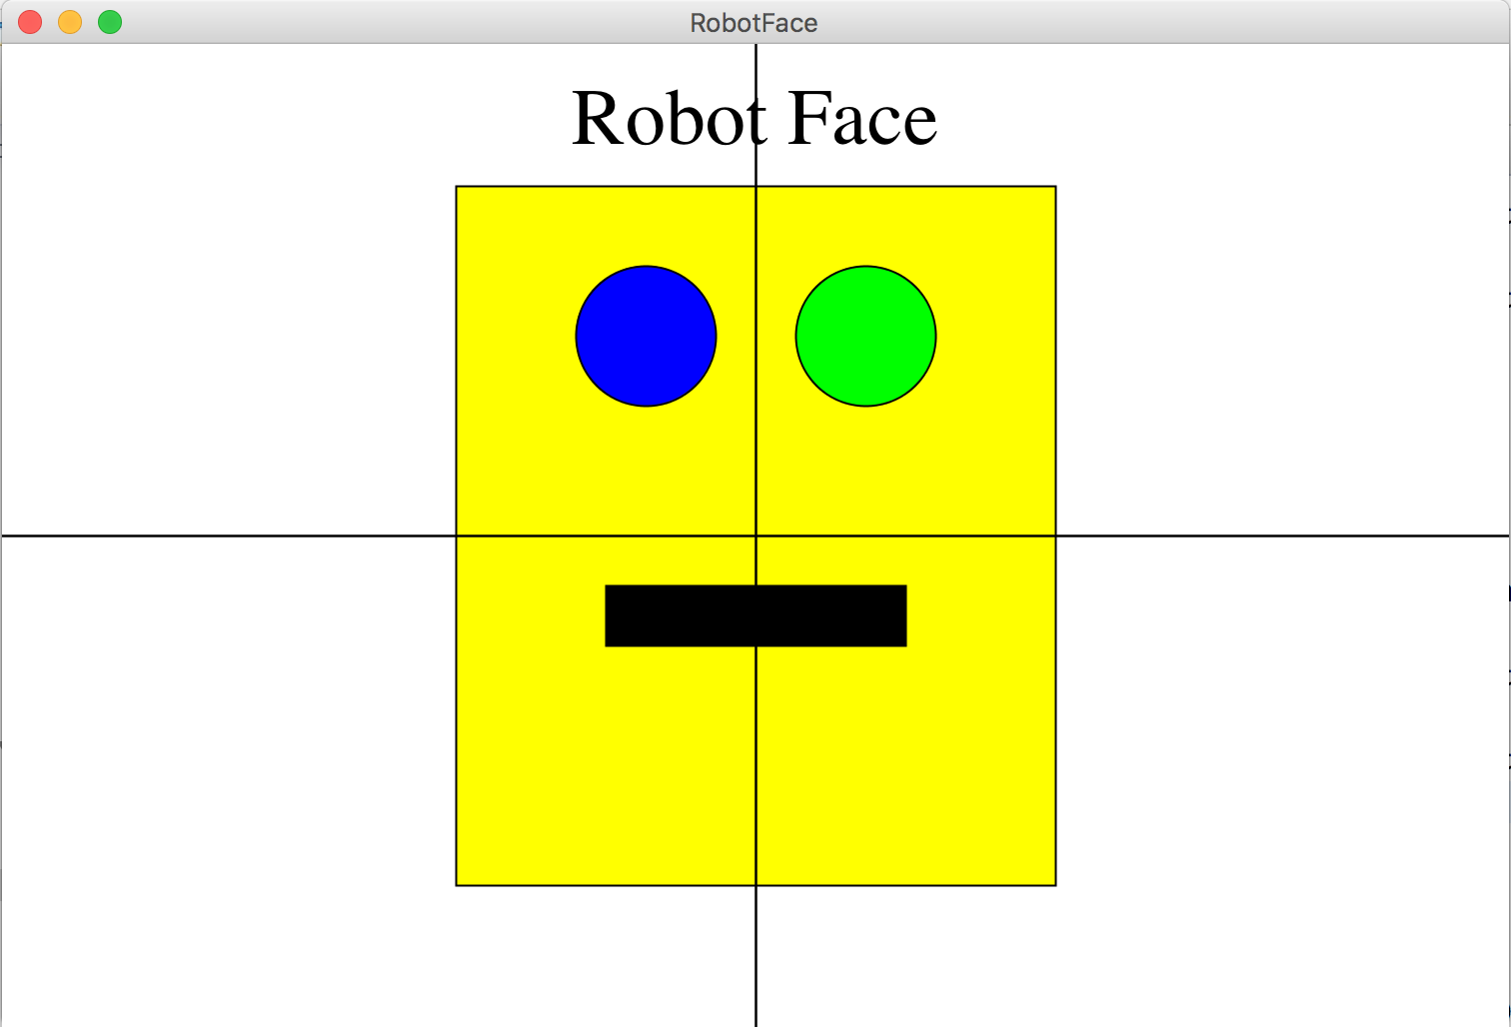
(bonus) Karel’s Grandpa

